Slide 1
RISC vs. CISC
with guidance from Rui Wang
& Tibor Horvath’s presentation

Slide 2
CISC
CISC: complex instruction set computer
But original CPUs very simple
Poorly suited to evolving high level languages
Extended with new instructions
e.g. function calls, non-linear data structures, array bound checking, string manipulation
Implemented in microcode (which are RISC like)
sub-machine code for configuring CPU sub-components
1 machine code == > 1 microcode
e.g. Intel X86 architecture

Slide 3
CISC continued
CISC introduced integrated combinations of features
e.g. multiple address modes, conditional execution
required additional circuitry/power
multiple memory cycles per instruction
over elaborate/engineered
many feature combinations not often used in practise
Could lead to loss of performance
Better to use combinations of simple instructions

Slide 4
CISC Problems
Performance tuning unsuccessful
Rarely used high-level instructions
Sometimes slower than equivalent sequence
High complexity
Pipelining bottlenecks → lower clock rates
Interrupt handling can complicate even more
Marketing
Prolonged design time and frequent microcode errors hurt competitiveness

Slide 5
More about CISC
Wired logic → microcode control
Temptingly easy extensibility
Performance tuning
HW implementation of some high-level functions
Marketing
Add successful instructions of competitors
“New feature” hype
Compatibility: only extensions are possible

Slide 6
RISC
RISC: reduced instruction set computer
return to simpler design
general purpose instructions with small number of common features
less circuitry/power
execute in single cycle
code size grew
performance improved
e.g. ARM, MIPS

Slide 7
RISC Features
Low complexity
Generally results in overall speedup
Less error-prone implementation by hardwired logic or simple microcodes
VLSI implementation advantages
Less transistors
Extra space: more registers, cache
Marketing
Reduced design time, less errors, and more options increase competitiveness

Slide 8
RISC Compiler Issues
The compilers themselves
Computationally more complex
More portable
The compiler writer
Less instructions → probably easier job
Simpler instructions → probably less bugs
Can reuse optimization techniques

Slide 9
RISC vs. CISC misconceptions
Arguments favoring RISC: simple design, short design time, speed, price…
Study of RISC should include hardware/software tradeoffs, factors influencing computer performance and industry-side evaluation.

Slide 10
RISC vs. CISC misconceptions
Incorrect implication from the two acronyms: RISC and CISC.
They are not bifurcations between which designers have to choose
Carelessly leaving out the ‘participation’ of Operating System

Slide 11
RISC vs. CISC misconceptions
Reduced design time?
academic <-> industrial
Performance claims of RISC proponent do not decouple design features like MSRs (Model Specific Register).
MRSs can have a remarkable effect on program execution

Slide 12
Conclusion – RISC vs. CISC?
CISC
Effectively realizes one particular High Level Language Computer System in HW - recurring HW development costs when change needed
RISC
Allows effective realization of any High Level Language Computer System in SW - recurring SW development costs when change needed

Slide 13
Conclusion – Optimum?
Hybrid solutions
RISC core & CISC interface
Still has specific performance tuning
Optimal ISA
Between RISC & CISC
Few, carefully chosen, useful complex instructions
Still has complexity handling problems

Slide 14
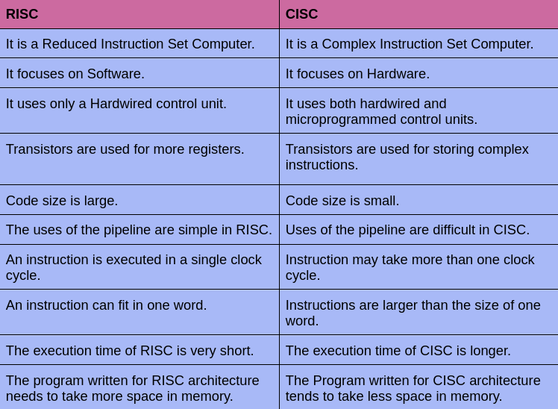
CISC vs RISC

Slide 15
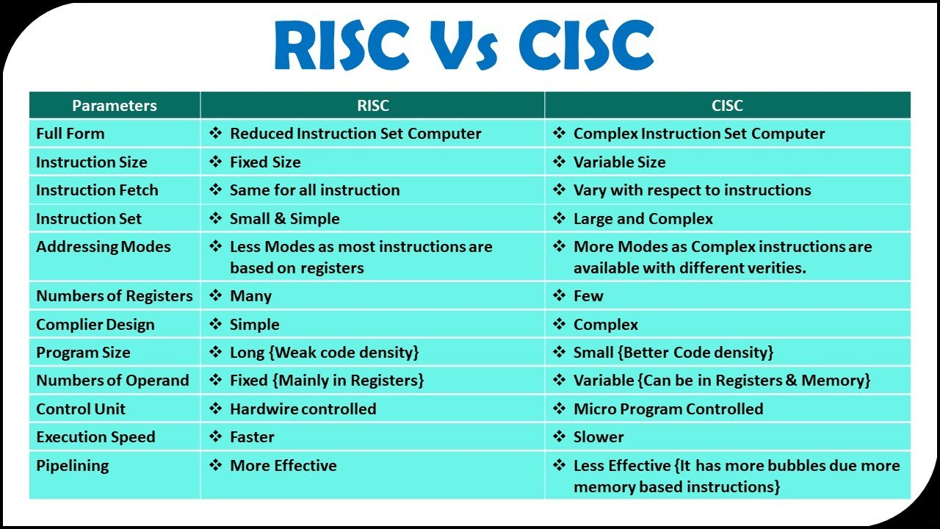

Slide 16
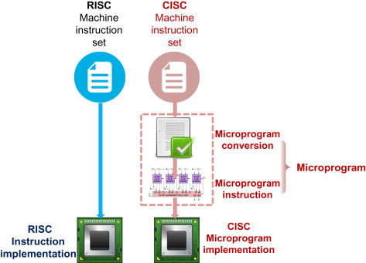
CISC vs RISC

Slide 17
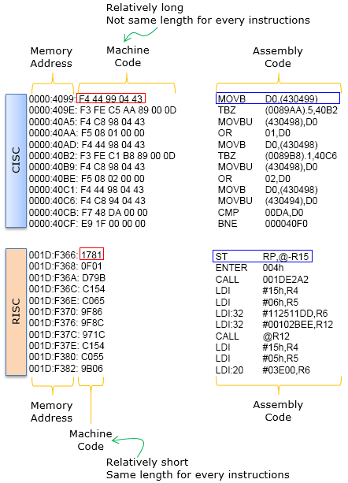
CISC vs RISC

Slide 18
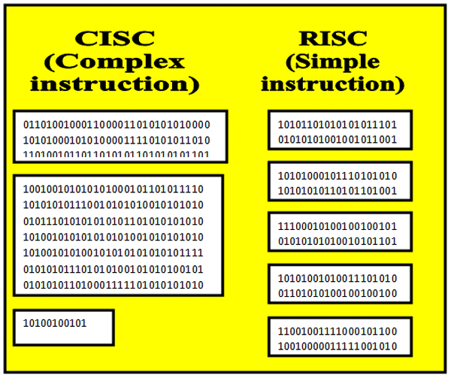
CISC vs RISC

Slide 19
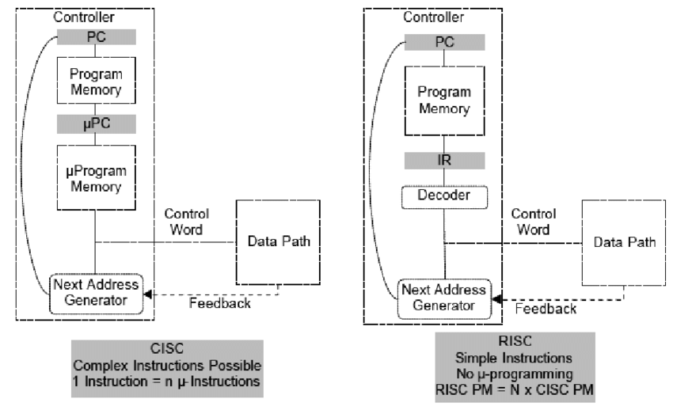
CISC vs RISC

Slide 20
CISC vs RISC
https://cs.stanford.edu/people/eroberts/courses/soco/projects/risc/risccisc/

